Slide 1

Dynamics CRM Form Design Art or Science?

Slide 2

Mitch Milam
Dynamics CRM Architect
Independent consultant and trainer
mitch@xrmcoaches.com
infinite–x.net
@mitchmilam

Slide 3
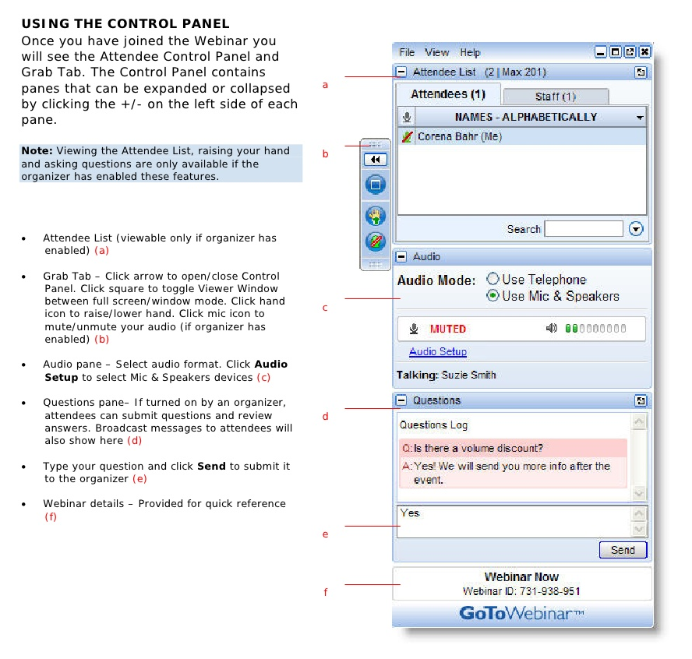
Webinar Housekeeping

Slide 4
Future Events
TBD – Trying to schedule around spring break

Slide 5



2016 Training Roadmap
Webinars
http://www.xrmcoaches.com/webinars
KnowledgeBits
http://www.xrmcoaches.com/knowledgebits
Learning Plans
Availability –Coming soon
More Goodies
Practice tests
On–Demand video training
Instructor–led training
Books

Slide 6
Agenda
General design thoughts
Working with tabs, sections, and fields
Different form types
Mobile considerations
Upgrade considerations

Slide 7
General Design Thoughts

Slide 8
General Design Thoughts
Pay attention:
To what data users enter
Where it is located
How often it is updated
Requirement levels

Slide 9
Multiple Forms
Should you have multiple forms?
Can you not just hide/show tabs and sections?
Are there JavaScript web resources involved?

Slide 10
Tabs

Slide 11
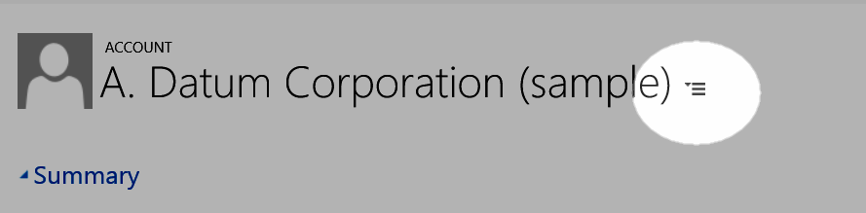
Tab Selector

Slide 12
Collapsed vs. Expanded
Best Practices:
If the tab does not contain relevant or often–used data, then collapse the tab
If the tab contains an iFrame that is only occasionally used, then collapse the tab

Slide 13
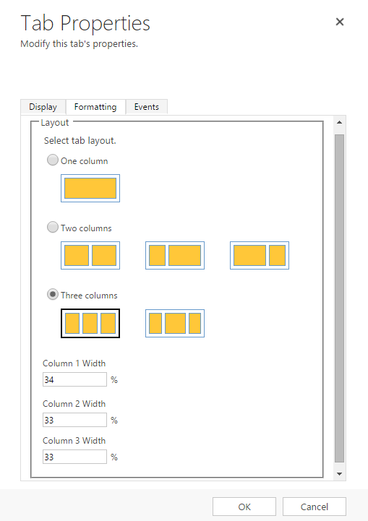
Tab Formatting

Slide 14
Sections

Slide 15
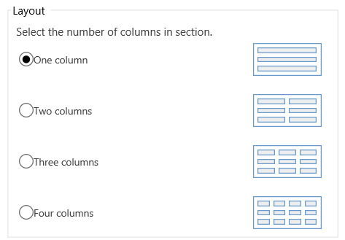
Layout

Slide 16
Layout Best Practices
Be mindful of the overall page width
Your user’s minimum monitor resolution will determine the maximum layout size
Testing on your machine is not valid!

Slide 17
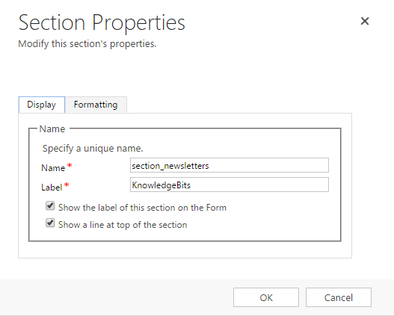
Section Label

Slide 18
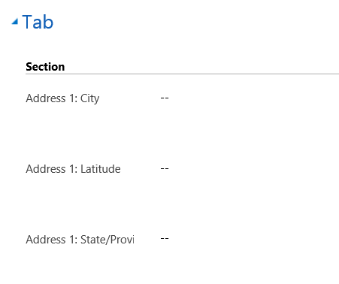
Example

Slide 19
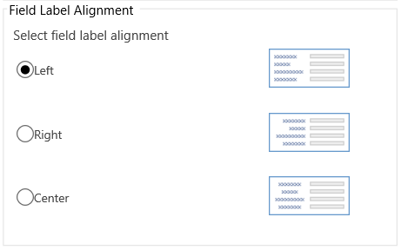
Field Label Alignment

Slide 20
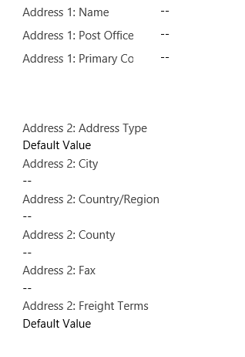
Example 1
Mixing field label positions

Slide 21
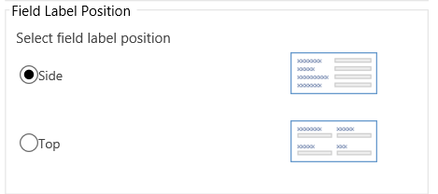
Field Label Position

Slide 22
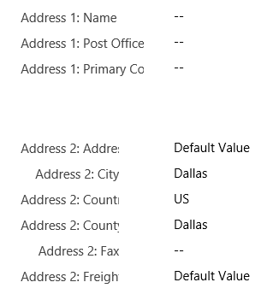
Example 2
Field label alignment

Slide 23
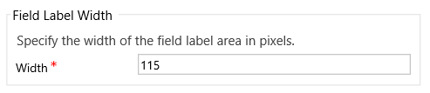
Field Label Width

Slide 24
Example
Default (115)
Width (80)
Width (60)

Slide 25
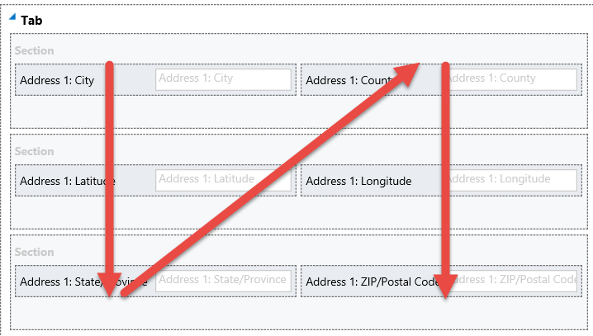
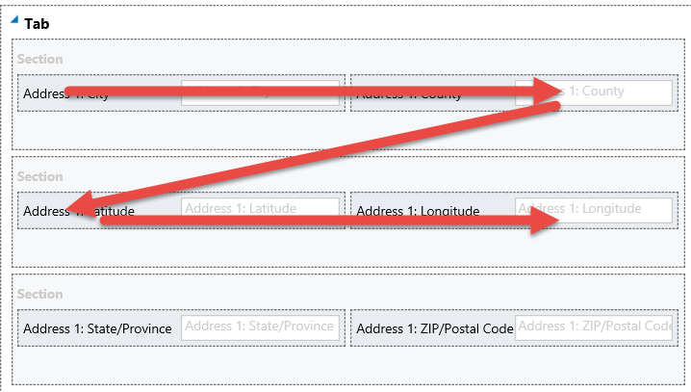
Tab Order
N–Order
Z–Order

Slide 26
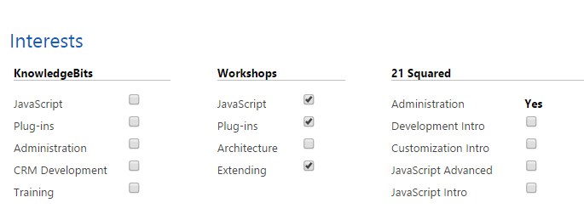
Vertical or Horizontal?

Slide 27
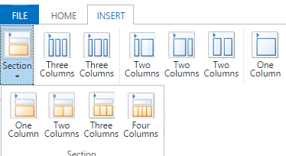
Multi–Column Tabs or Sections?

Slide 28
Final Thoughts on Sections
Interesting and productive layouts can be created
Do not overpower users with design elements
Be consistent

Slide 29
Fields

Slide 30
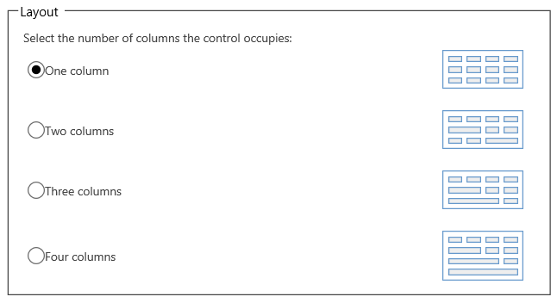
Field Column Width

Slide 31
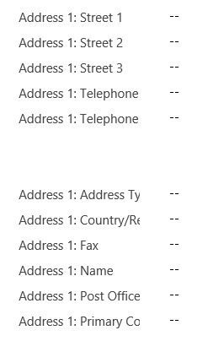
Hiding Fields
Two–Column Section

Slide 32
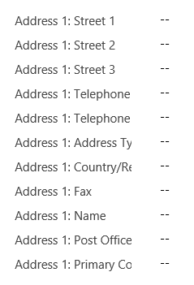
Hiding Fields
One–Column Section

Slide 33
Hidden Fields
Should you make them read–only instead?

Slide 34
Required Fields
If possible, arrange all of your required fields near each other

Slide 35
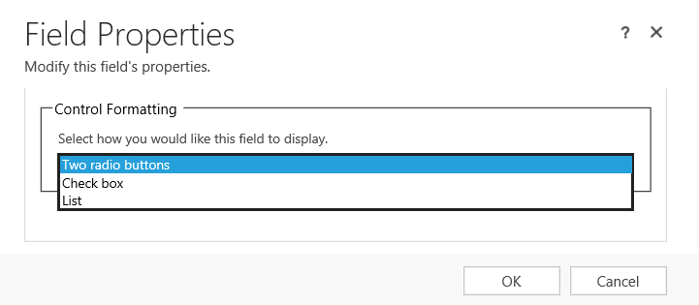
Two–Option Fields
What is the best format?

Slide 36
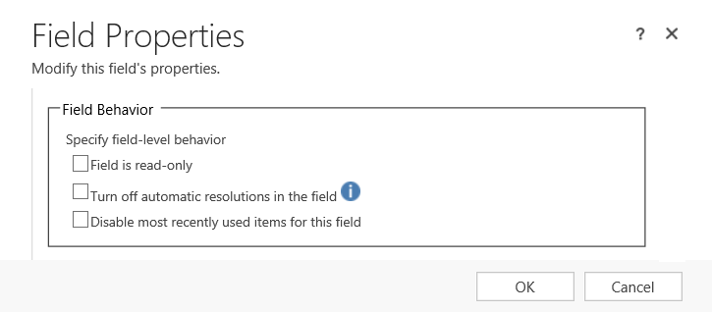
Lookups
Change the default behavior

Slide 37
“Turbo” vs. Legacy Forms

Slide 38
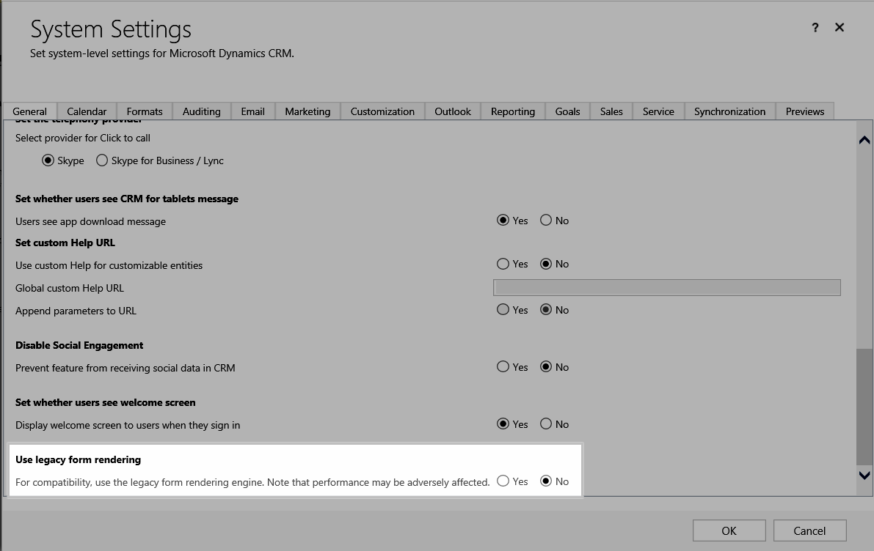
Activation

Slide 39
Observations
They behave slightly different than legacy
Some features will not work
In some instances, there may be JavaScript issues

Slide 40
Quick–Create Forms

Slide 41
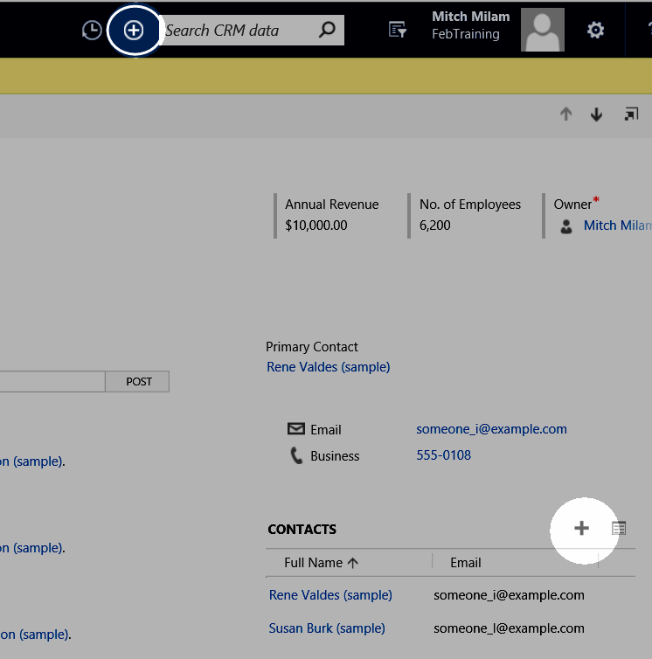
Dual Purpose

Slide 42
Quick View Forms

Slide 43
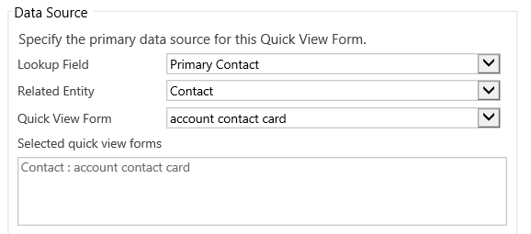
Quick View Forms
Shows related–entity data on a form

Slide 44
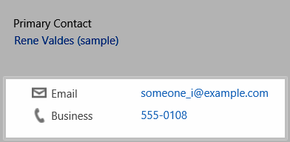
Example

Slide 45
Related Data

Slide 46
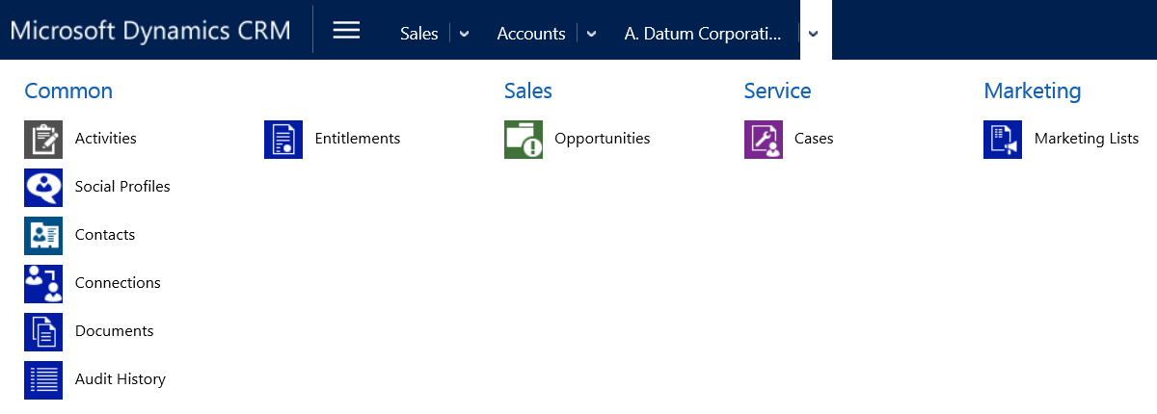
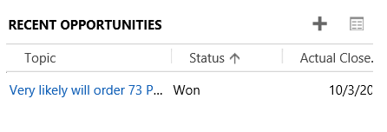
Related Data
Navigation vs. Embedded Grids

Slide 47
Social Pane

Slide 48
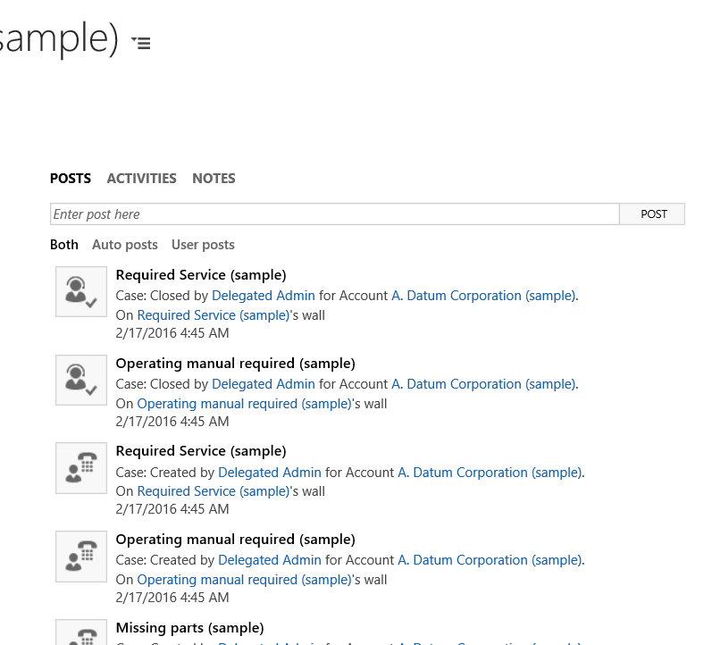
Social Pane
The elephant on the form

Slide 49
Social Pane
You can:
Leave it in place
Move it to another tab (lower on the form)
Remove it

Slide 50
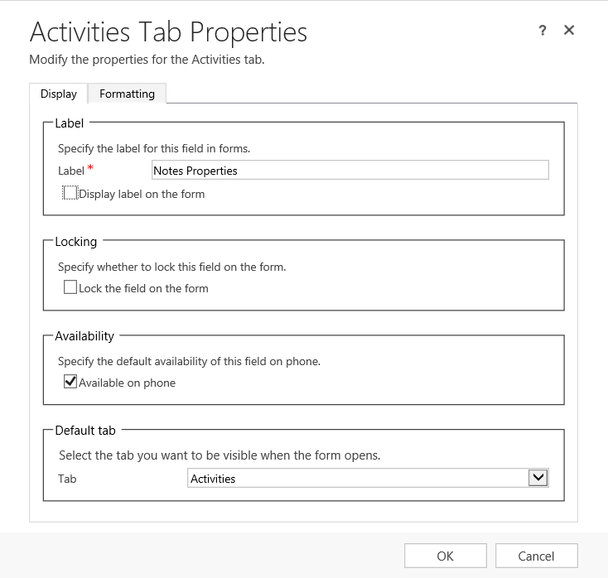
Properties

Slide 51
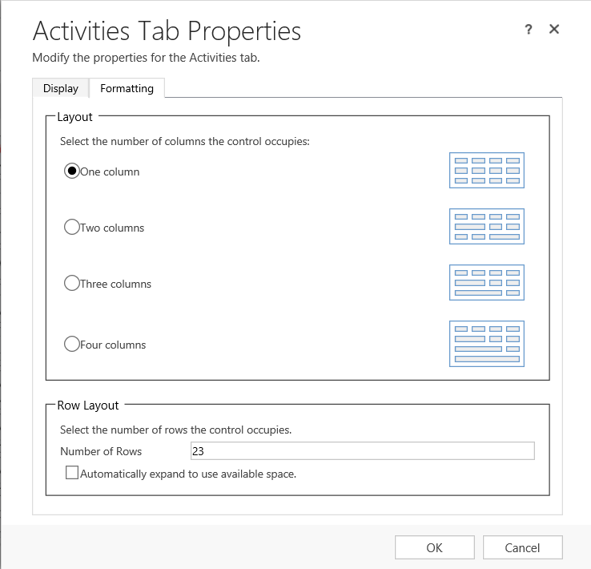
Formatting

Slide 52
Mobile Considerations

Slide 53
Mobile Layout
Horizontal instead of vertical (desktop)
Many layout settings are ignored

Slide 54
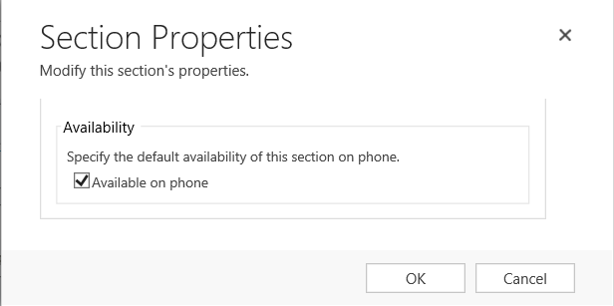
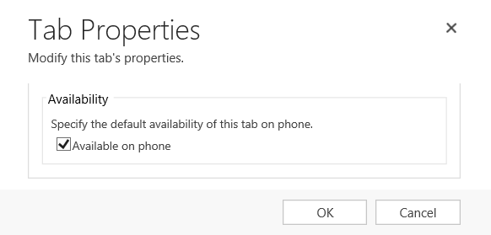
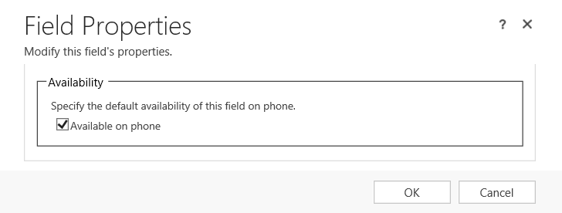
Control Availability

Slide 55
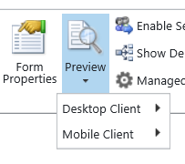
Mobile Form Preview

Slide 56
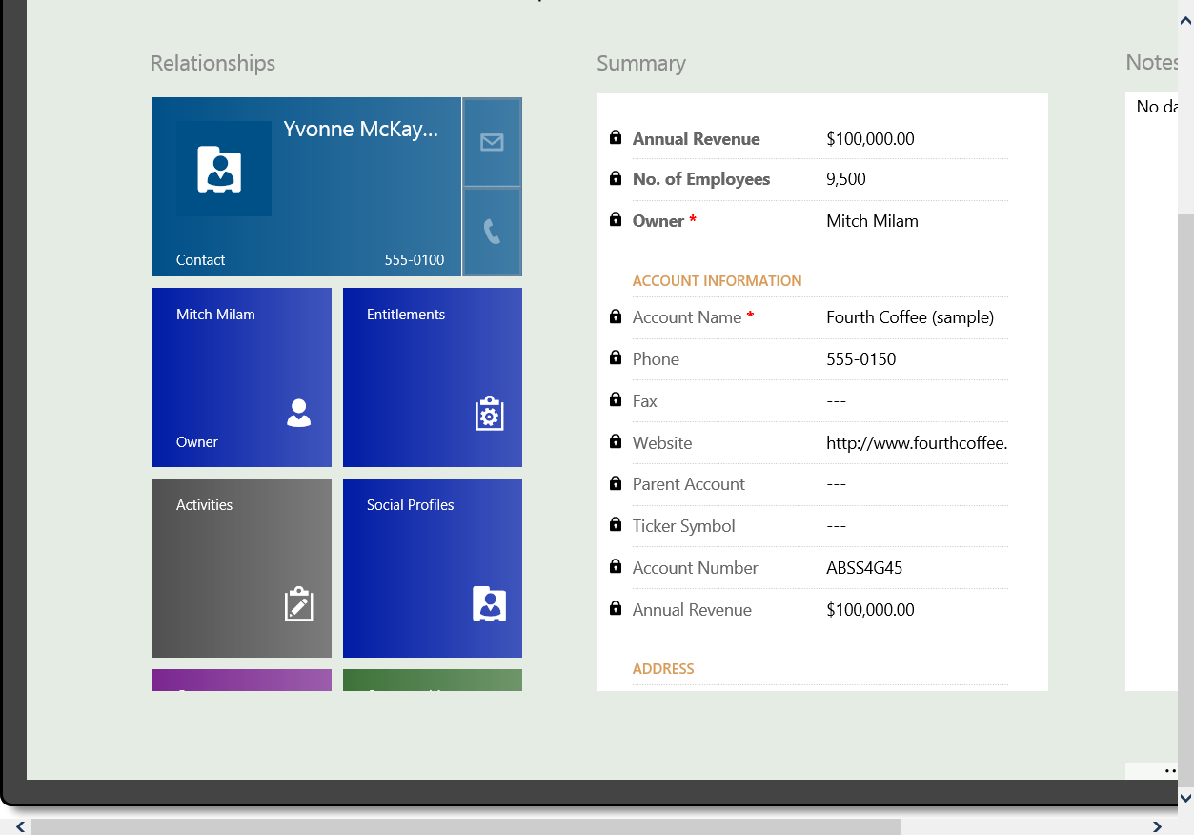
Mobile Form Preview (Tablet)

Slide 57
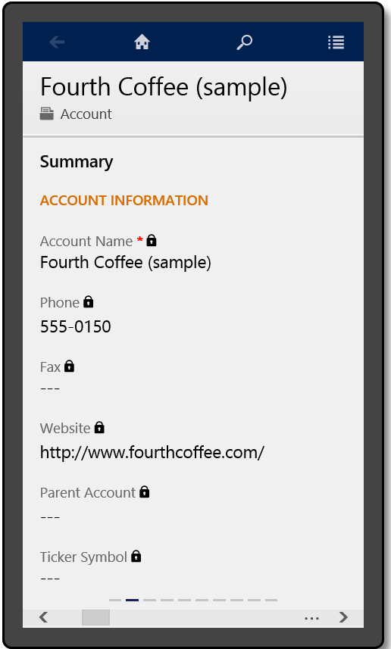
Mobile Form Preview (Phone)

Slide 58
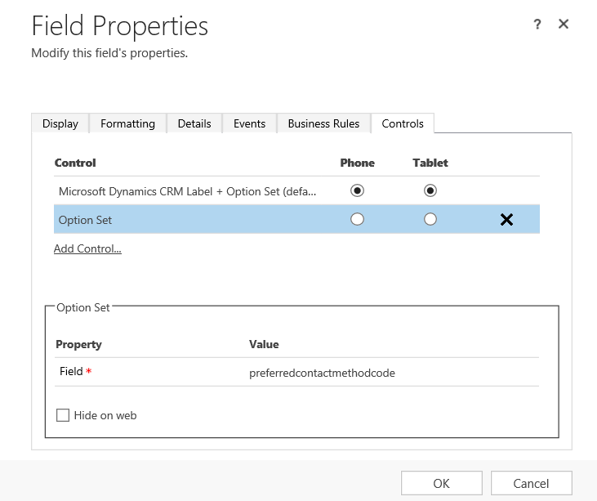
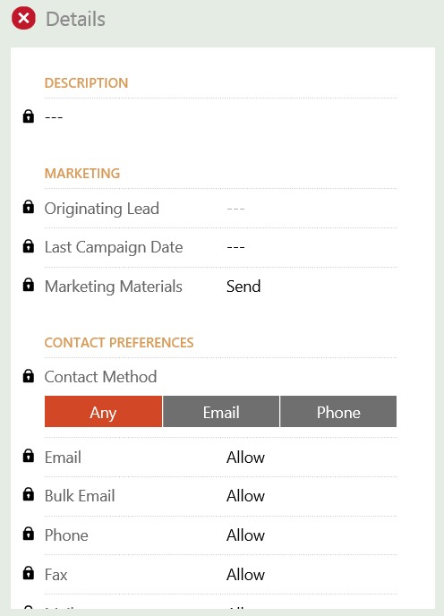
Utilize New Mobile Controls

Slide 59




Mobile Controls
Linear slider
OptionSet
Switch
Rating

Slide 60


Mobile Controls
Radial Knob
Multimedia

Slide 61
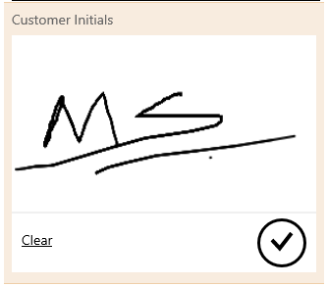

Mobile Controls
Pen
Website preview

Slide 62

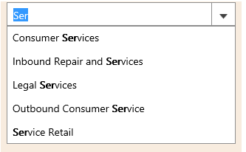

Mobile Controls
Number Input
Auto–Complete
Input mask

Slide 63


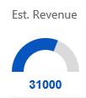
Mobile Controls
Linear gauge
Actual revenue
Arc knob

Slide 64
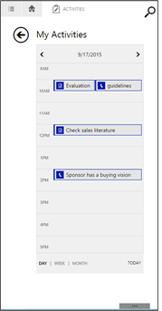
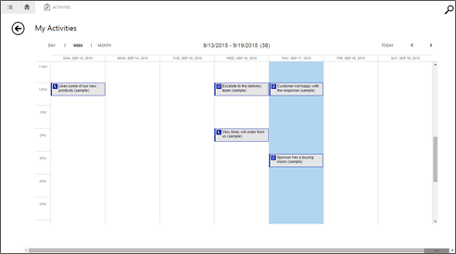
Mobile Controls
Calendar

Slide 65
Upgrade Considerations

Slide 66
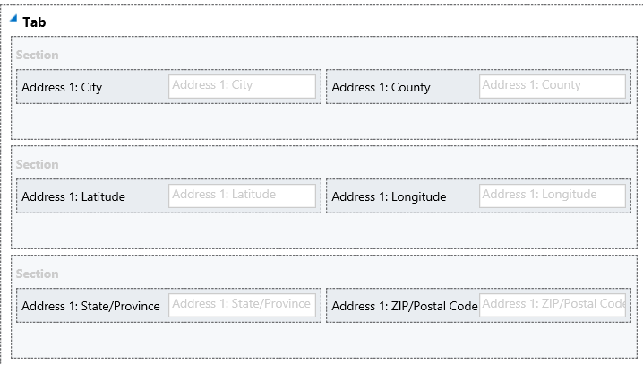
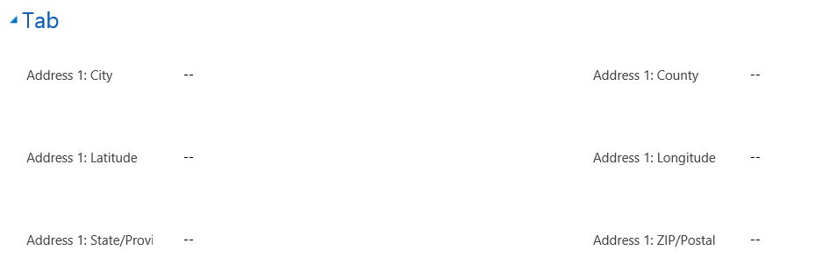
“Horizontal Tab” Design

Slide 67
Merging Forms
Use extreme caution
Avoid, if possible

Slide 68
Discussions

Slide 69
Questions?

Slide 70
Thank You

